Slide 1
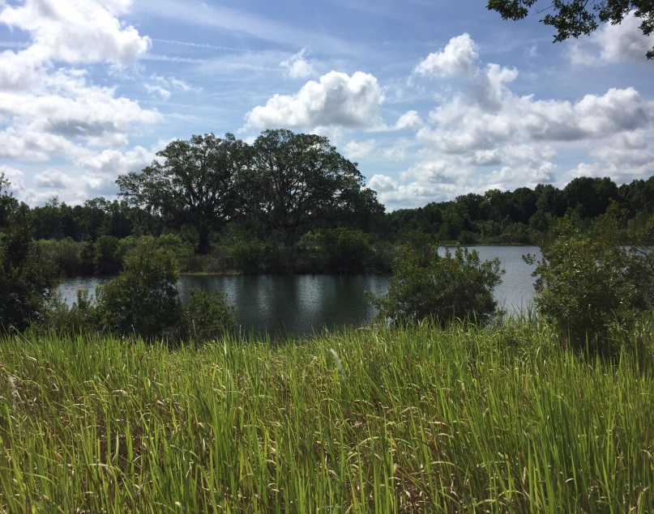
FOR
SALE
Commercial Land
44001 Rolling Hill Rd, Callahan, Florida 32011
Price: $2,500,000
Approx. 3,000 ft. of frontage on SR 301
Land Size: 90 +/- AC
Features:
Highly visible property with approx. 3,000 ft. of road frontage and is located just two miles south of Callahan FL. This land has endless development opportunities including residential tracts or and RV Park.
Subject
Tom Gonseth Phone: (904) 280-4444
Gonseth@killasheeinv.com Cell: (904) 571-1790
228 Canal Boulevard, Suite 4 Fax: (904) 280-4400
Ponte Vedra Beach, FL 32082 Website: www.killasheeinv.com
Although all information furnished regarding for sale, rental or financing is from sources deemed reliable, such information has not been verified and no express representation is made nor is any to be implied as to the accuracy thereof and is submitted subject to errors, omissions, changes of price, rental or other conditions, prior to assignment, of contract, sale, lease or financing or withdrawal without notice.
Notes:
The gold font color is red:173, green:175, blue:78

Slide 2
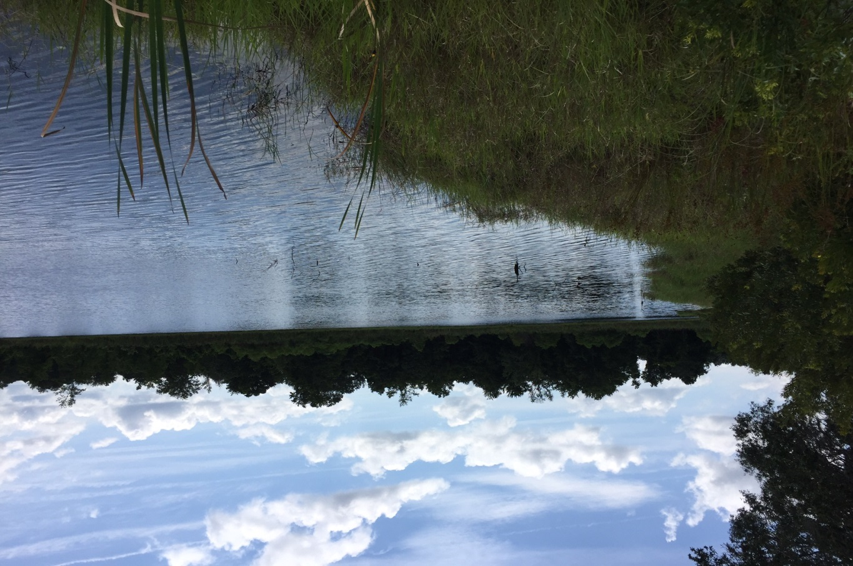
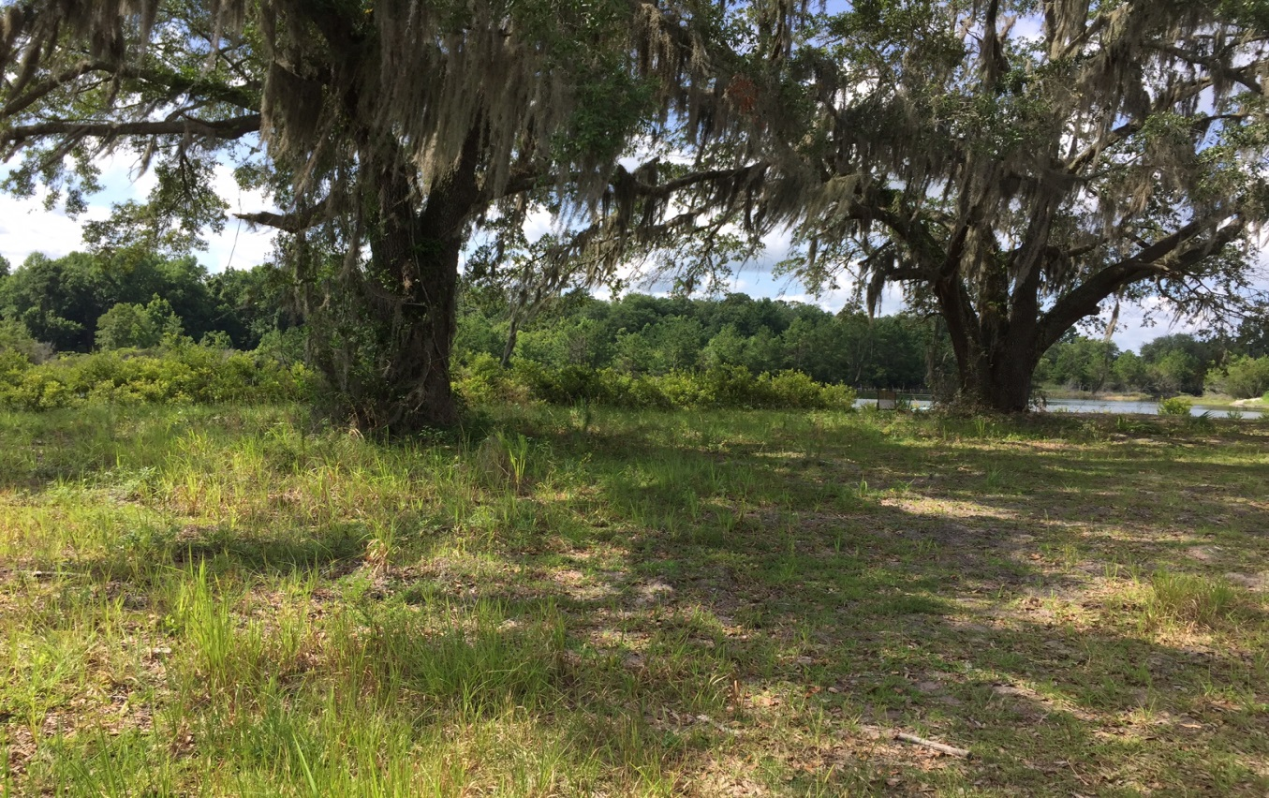
Although all information furnished regarding for sale, rental or financing is from sources deemed reliable, such information has not been verified and no express representation is made nor is any to be implied as to the accuracy thereof and is submitted subject to errors, omissions, changes of price, rental or other conditions, prior to assignment, of contract, sale, lease or financing or withdrawal without notice.

Slide 3
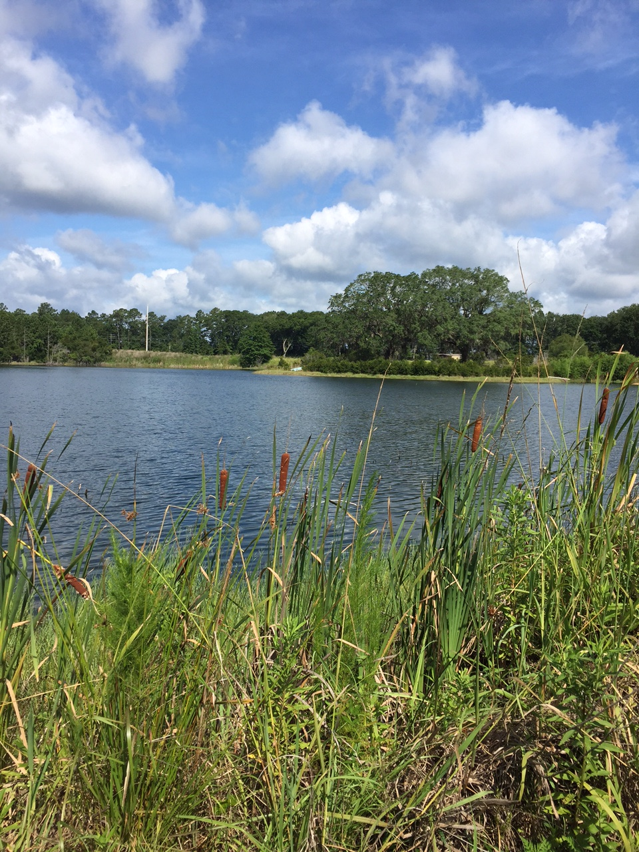

Slide 4
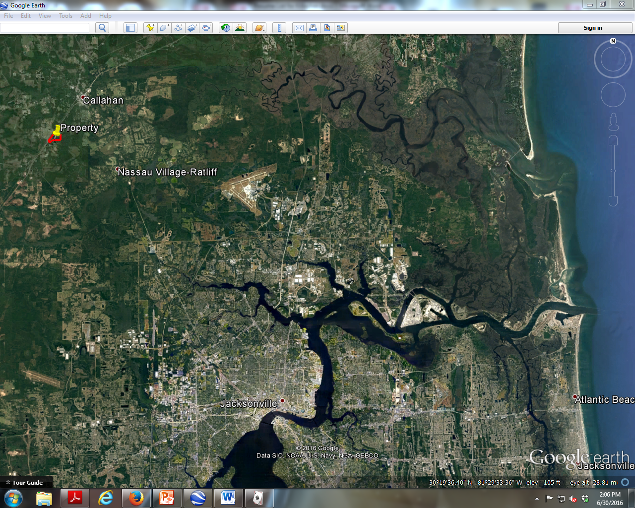
Property

Slide 5
